Slide 1



Bankers vs. Technologists
Financial Institutions
Technologists
Security conscious
Risk aversion
Practitioner
Usually less versed with technology
Technology development driven
Pursuing new frontier
Dreamers
Usually less versed with financial services
Needs Active Dialogue and Collaboration

Slide 2

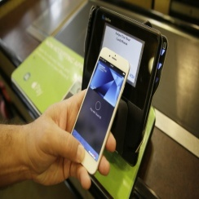

Fin + Tech
Applications
A cluster of Innovations involving the use of technology to make financial services
more efficient,
more effective,
more transparent,
more user-friendly,
more secure, etc.
Looking forward
Standing down to earth

Slide 3
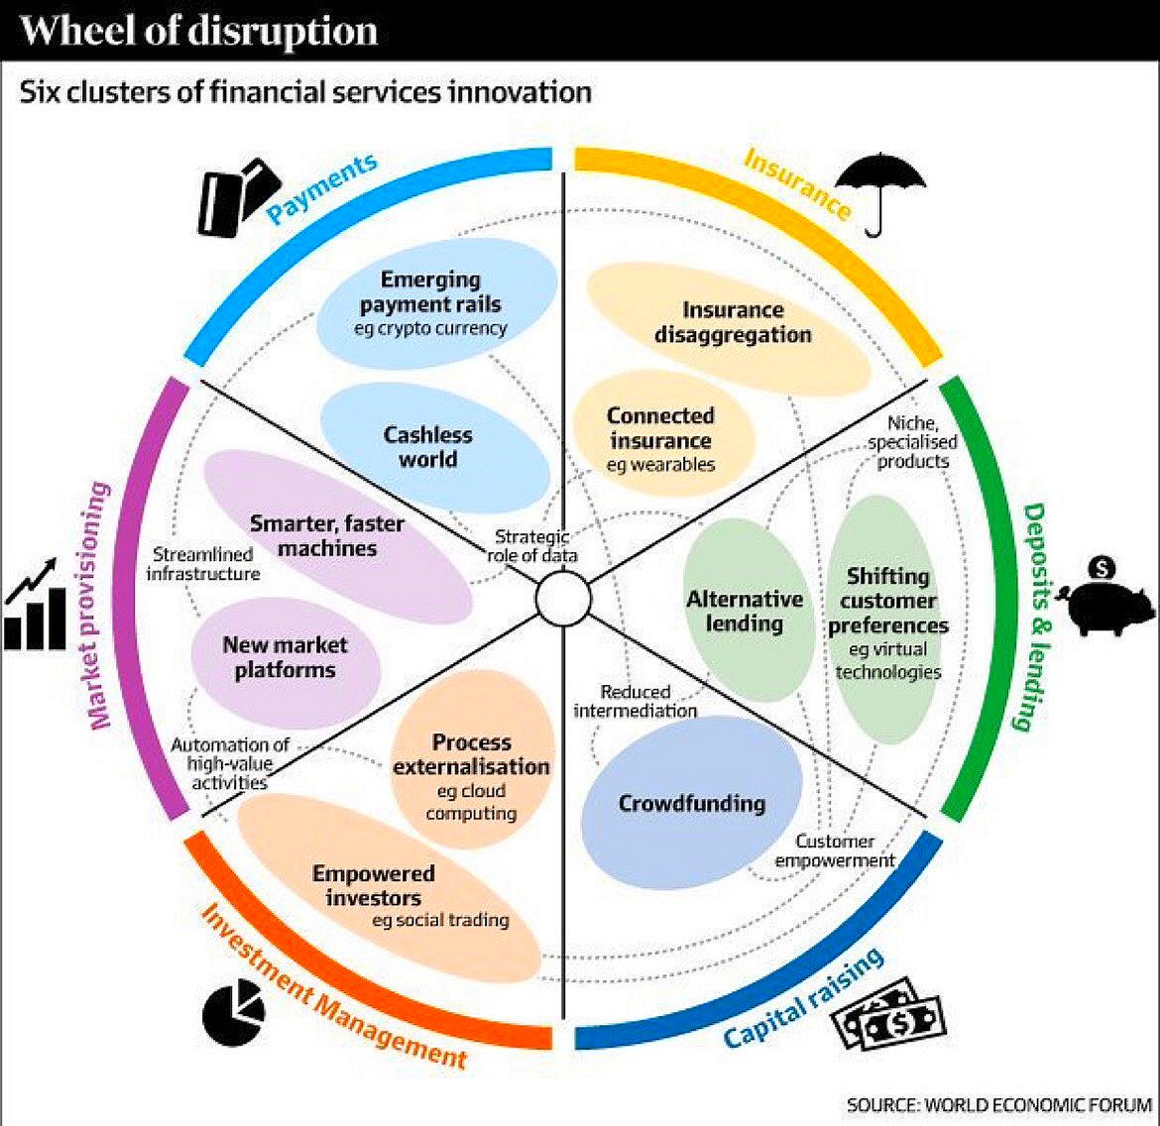
FinTech will reshape our lives!

Slide 4


Human Wisdom remains the Core
Souls and Spirits
Science and Art.
EVEN
SPIRIT
Human Wisdom

Slide 5

Mutual Enlightenment & Cooperation

Slide 6

Opportunities and Challenges
Cross the River whilst Touching the Stones!
We will continue exploring FinTech!

